Slide 1
GOOGLE DORKS
Cyber Security
SHAH MUHAMMAD, CS-VIII

Slide 2
AGENDA OF THE PRESENTATION
What is Google Dorks?
How Google Dorks works?
Google Dorks Queries
Some Examples
Demo

Slide 3
Google Dorks
A Google dork query, sometimes just referred to as a dork, is a search string or custom query that uses advanced search operators to find information not readily available on a website.
Google dorking, also known as Google hacking, can return information difficult to locate through simple search queries.
There are different places to find ready to use Google Dorks. The first place is Google Hacking Database. This is a free public database containing thousands of Google Dorks for finding sensitive publicly available information

Slide 4
Is It legal ?
Google dorking is completely legal —
it's just another form of searching after all.
Google was built to handle advanced searches, and banning this functionality would limit information access.

Slide 5
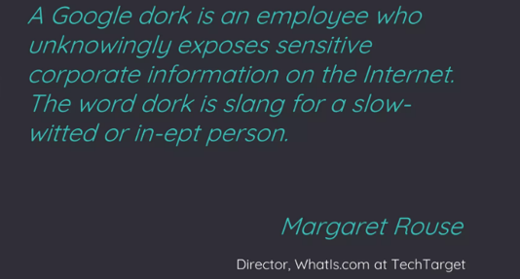
Google Dorks

Slide 6
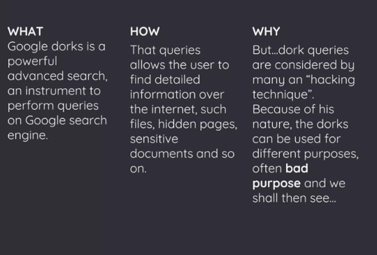
Purpose of Dorks Queries

Slide 7
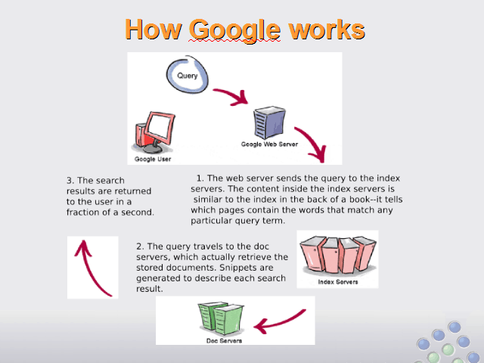
How Google Works

Slide 8
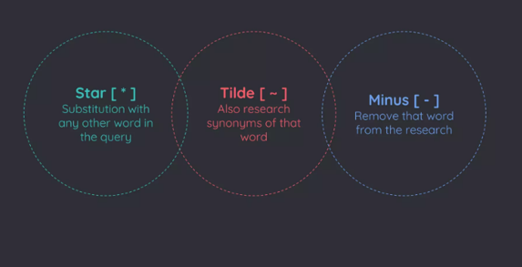
Special Characters

Slide 9
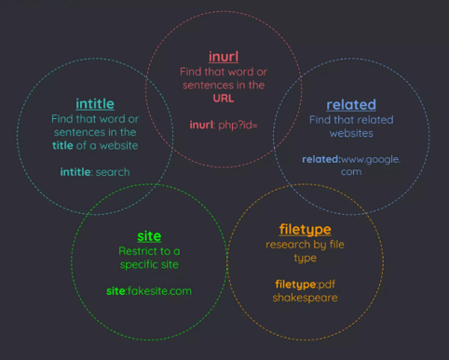
Operators

Slide 10
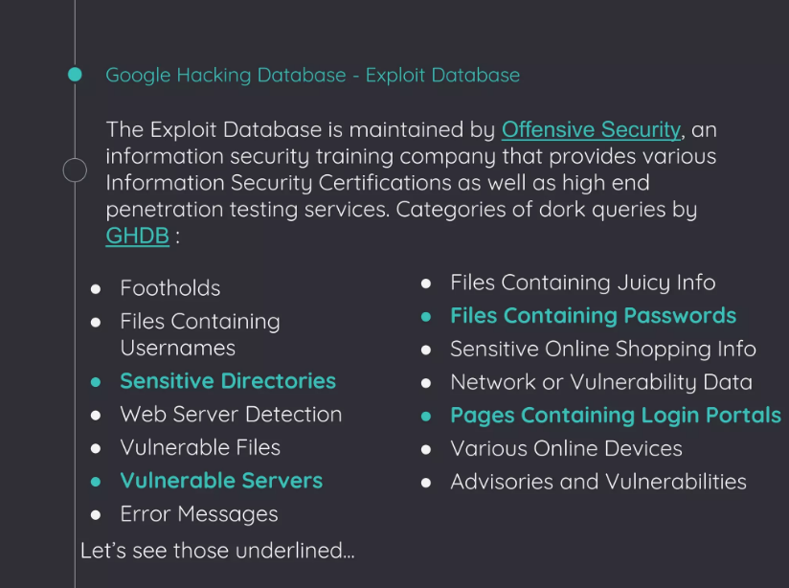

Slide 11
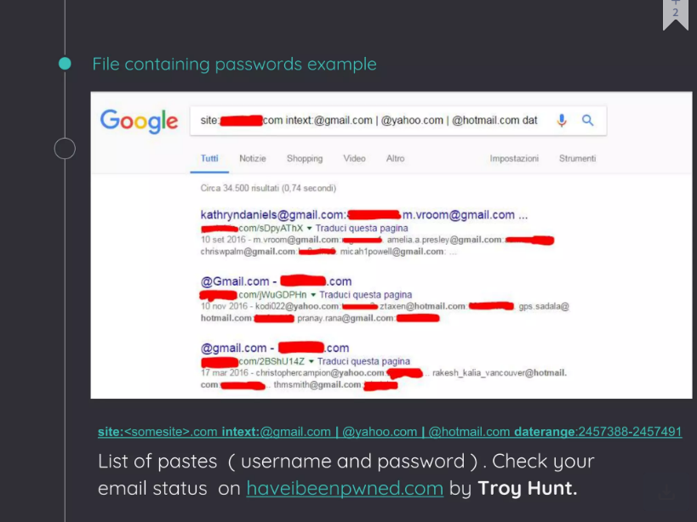

Slide 12
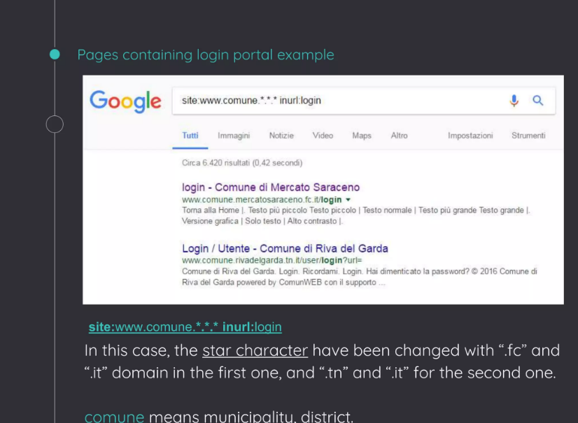

Slide 13
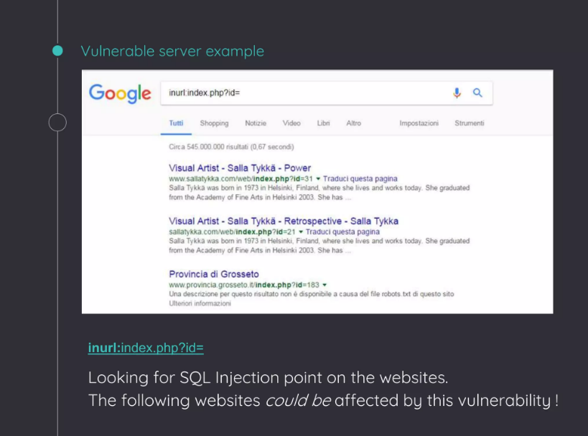

Slide 14
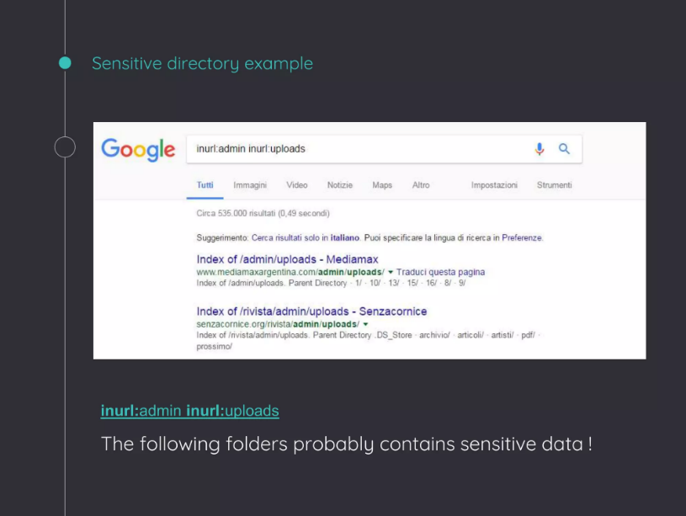

Slide 15
DEMO
Finding exposed FTP servers
Google can index open FTP servers. Use the following Google Dork to find open FTP servers.
intitle:"index of" inurl:ftp
To make the query more interesting, we can add the "intext" Google Dork, which is used to locate a specific word within the returned pages
https://www.google.com/advanced_search

Slide 16
DEMO
2. Find email lists
It is relatively easy to find email lists using Google Dorks. In the following example, we are going to find text files that contain email lists.
filetype:txt inurl:"email.txt"

Slide 17
DEMO
3. Getting live streams of Cameras
Live cameras We can use Google to find open cameras that are not access restricted by IP address. The following Google dorks retrieve live cameras web pages.
inurl:"view.shtml" "Network Camera“
"Camera Live Image" inurl:"guestimage.html"

Slide 18
DEMO: Finding Passwords
Finding passwords is the most attractive task for both legitimate and ill-intentioned online searchers. The following Google Dorks retrieve exposed passwords.
site:pastebin.com intext:admin.password
(find the text "admin.password" in the Pastebin website; this site is used by hackers to publish sensitive leaked information)
"admin_password" ext:txt | ext:log | ext:cfg
(find the text “admin-password” in exposed files of the following types: TXT, LOG, CFG)
filetype:log intext:password after:2016 intext:@gmail.com | @yahoo.com | @hotmail.com
(search for all files of type "log" that contain the word "password" within them, are indexed after 2016, and contain any of the following text in their body: @gmail.com, @yahoo.com, or @hotmail.com)

Slide 19
Some Examples of Dorking Queries
site:static.ow.ly/docs/ intext:@gmail.com | Password
filetype:sql intext:wp_users phpmyadmin
intext:"Dumping data for table orders"
"Index of /wp-content/uploads/backupbuddy_backups" zip
Zixmail inurl:/s/login?
inurl:/remote/login/ intext:"please login"|intext:"FortiToken clock drift detected"
inurl:/WebInterface/login.html
inurl:dynamic.php?page=mailbox
inurl:/sap/bc/webdynpro/sap/ | "sap-system-login-oninputprocessing"
intext:"Powered by net2ftp"

Slide 20
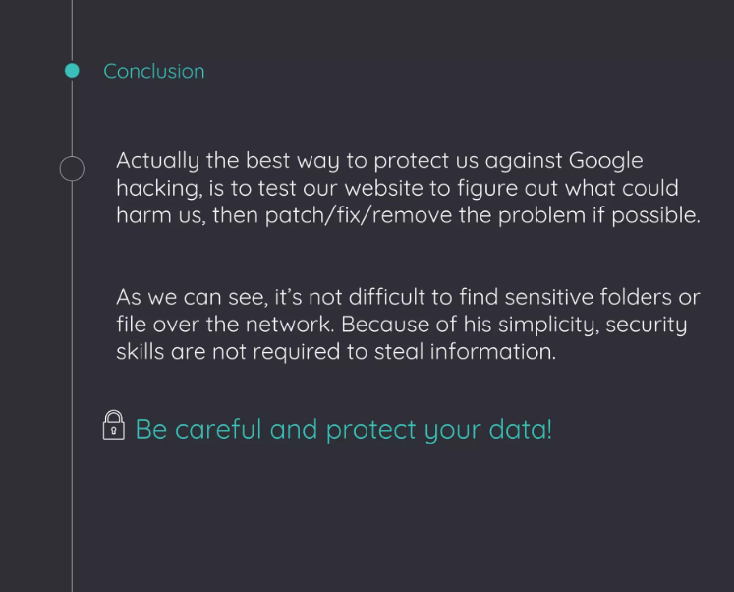

Slide 21


